Slide 1

3. Normalization and exploratory analysis
Jose Alejandro Romero Herrera
Data Scientist

Slide 2
Agenda
Data correction and normalization
RPKM/FPKM-TPM-DESeq2
Exploratory analysis
PCA, Pearson correlation,
distance heatmaps
Workflow
Differential Expression Analysis
Comparison between conditions
Functional analysis
Gene-gene correlation
Networks
GO term

Slide 3
Workflow
Experimental design
Isolate RNA
Prepare library
Data correction and normalization
Untreated
Treated
Correlation between samples
Sequence
Filter and clean reads
FastQ files
Workflow
Differential Expression Analysis
Paired end reads
Single reads
Gene-gene correlation Networks
GO term
Paired end reads
Single reads
Align to reference
Create gene count matrix
 | Untreated 1 | Untreated 2 | Treated 1 | Treated 2
Gene A | 123 | 150 | 143 | 130
Gene B | 18 | 10 | 233 | 209
100 b
150 b
200 b
250 b
Bam files

Slide 4
Data correction. Raw count matrix
Gene Name | Rep1 Counts | Rep2 Counts | Rep3 Counts
A (2 Kb) | 10 | 12 | 30
B (4 Kb) | 20 | 25 | 60
C (1 Kb) | 5 | 8 | 15
D (10 Kb) | 0 | 0 | 1
Total counts | 35 | 45 | 106
Is the expression of gene A higher in Rep3 than Rep1?
Is the expression of gene A higher than gene B in Rep1?
Do you think it is ok to compare genes and reps using this table?

Slide 5
Data correction. Biases
Gene Name | Rep1 Counts | Rep2 Counts | Rep3 Counts
A (2 Kb) | 10 | 12 | 30
B (4 Kb) | 20 | 25 | 60
C (1 Kb) | 5 | 8 | 15
D (10 Kb) | 0 | 0 | 1
Total counts | 35 | 45 | 106
Gene length bias (Kb)
Longer genes will have more reads mapping to them
Library size bias (total counts)
Deeper runs will have more reads mapping to each gene

Slide 6
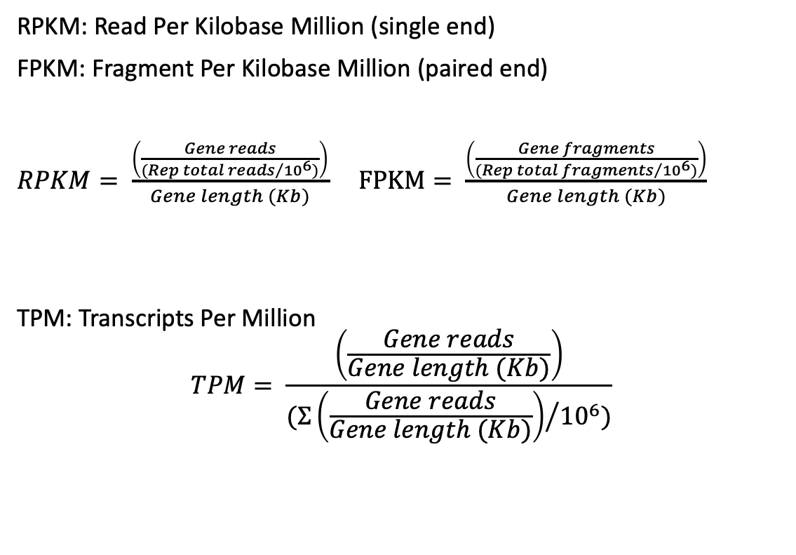
Data correction. Formulas
Gene Name | Rep1 counts | Rep2 counts | Rep3 counts
A (2 Kb) | 10 | 12 | 30
B (4 Kb) | 20 | 25 | 60
C (1 Kb) | 5 | 8 | 15
D (10 Kb) | 0 | 0 | 1
Total counts | 35 | 45 | 106
Original
RPKM: Read Per Kilobase Million (single end)
FPKM: Fragment Per Kilobase Million (paired end)
$RPKM= \frac{\left(\frac{Gene reads}{{(Rep total reads}/{{10}^{6})}}\right)}{Gene length (Kb)}$ $FPKM= \frac{\left(\frac{Gene fragments}{{(Rep total fragments}/{{10}^{6})}}\right)}{Gene length (Kb)}$
TPM: Transcripts Per Million
$$TPM= \frac{\left(\frac{Gene reads}{Gene length (Kb)}\right)}{{(Σ\left(\frac{Gene reads}{Gene length (Kb)}\right)}/{{10}^{6})}}$$
Gene Name | Rep1 RPKM | Rep2 RPKM | Rep3 RPKM
A (2 Kb) | 1.43 | 1.33 | 1.42
B (4 Kb) | 1.43 | 1.39 | 1.42
C (1 Kb) | 1.43 | 1.78 | 1.42
D (10 Kb) | 0 | 0 | 0.009
Total | 4.29 | 4.5 | 4.269
RPKM
*Divided by 10, not 10⁶
Gene Name | Rep1 TPM | Rep2 TPM | Rep3 TPM
A (2 Kb) | 3.33 | 2.96 | 3.326
B (4 Kb) | 3.33 | 3.09 | 3.326
C (1 Kb) | 3.33 | 3.95 | 3.326
D (10 Kb) | 0 | 0 | 0.02
Total | ~10 | ~10 | ~10
TPM
Notes:
DESeq: https://doi.org/10.1186/gb-2010-11-10-r106

Slide 7
Data correction. RPKM/FPKM
RPKM/FPKM
Sizes of pie charts are not the same!

Slide 8
Data correction. TPM
TPM
Sizes of pie charts are the same and it is easier to compare now
It is not recommend to use TPM/RPKM to compare gene expression between samples!!

Slide 9
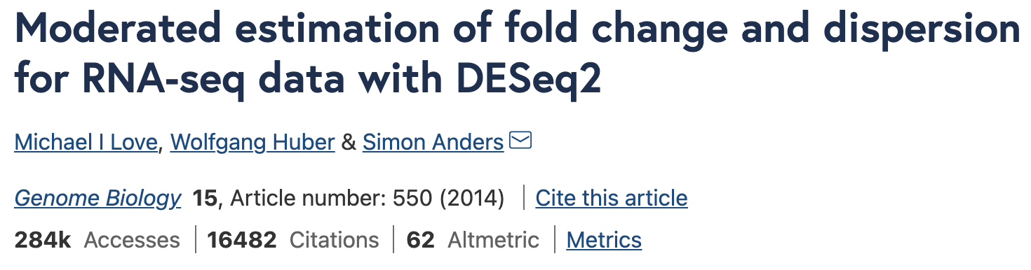
Data correction. DESeq2 package
One of the most (if not most) used packages for RNAseq analysis
Normalize your data
Very different than RPKM
Uses geometric means and size factor calculation
One of most popular normalization methods for DEA
Compare your samples
Find Differentially Expressed Genes between conditions
Notes:
DESEQ2 original paper: https://genomebiology.biomedcentral.com/articles/10.1186/s13059-014-0550-8
Usage tutorial: https://www.bioconductor.org/packages/devel/bioc/vignettes/DESeq2/inst/doc/DESeq2.html

Slide 10
Exploratory analysis. Data transformations
Useful to check samples
Replicates with same condition should be together
Distribution of gene count values is very skewed!
This will ruin most correlation/distances

Slide 11
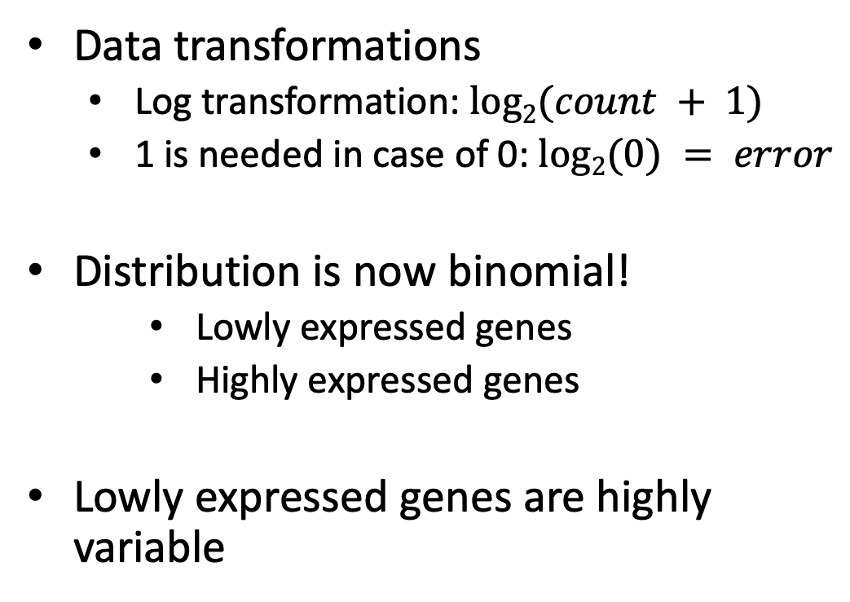
Exploratory analysis. Rlog or VST
Data transformations
Log transformation: $log2(count + 1)$
1 is needed in case of 0: $log2(0) = error$
Distribution is now binomial!
Lowly expressed genes
Highly expressed genes
Lowly expressed genes are highly variable

Slide 12
Sample correlation. Rlog or VST
Regularized logarithm (rlog) or Variance Stabilizing Transformation (vst)
Avoid high variance in when gene count is very low
Use now log2(count + n). ”n” is estimated by rlog or vst
vst
Log2(count + 1) Standard Deviation
VST Standard Deviation

Slide 13
Sample correlation. Visualizations
Rlog or vst are not used for Differential Expression Analysis (DEA)!
However, now we can compare our samples with a PCA or heatmaps
Principal Component Analysis (PCA)
Sample
distances

Slide 14
Sample correlation. Visualizations
Examples of when something is not right:

Slide 15
Sample correlation. Visualizations
Or batch effects! Imagine an experiment with three conditions:
Control
Treatment at 24h
Treatment at 48h
You run/sequence each condition in different days
You won’t be able to compare conditions
Completely confounded results!
Make sure you:
Do run all samples the same day - may be too much work
Do runs in different days that include all types of samples
Randomize your samples (not always is an option)

Slide 16
Sample correlation. Visualizations
Consult a bioinformatician before anything else!
Avoid batch effects and wasteful experiments
Check if you will want to compare against other RNAseq experiments
You can correct batch effects for visualization using limma/voom packages
 | Condition | Batch
Sample1 | Treated | 1
Sample2 | Treated | 1
Sample3 | Treated | 2
Sample4 | Control | 1
Sample5 | Control | 2
Sample6 | Control | 2
✓
 | Condition | Batch
Sample1 | Treated | 1
Sample2 | Treated | 1
Sample3 | Treated | 1
Sample4 | Control | 2
Sample5 | Control | 2
Sample6 | Control | 2
✗

